Slide 1
The Image of Migrant Farmworkers in Literature
Robin Jensen
Advisor: Professor Donaldo Urioste

Slide 2
Abstract
After working closely with the Latino community in Salinas I began to wonder about the struggles and difficulties migrant farm workers encounter when working in the fields and in their everyday lives. I wanted to learn more about their way of life, their conditions as agricultural workers, their resilience in their work and lives and of the contributions they provide to the surrounding communities. To this end, this research project investigates the history of farm workers in the U.S. Southwest, explores their mode of living, and examines the conditions under which they work on a daily basis. In order to exemplify the struggles and hard work of the migrant farm working community our study also examines various works of literature to see how different authors portray the harsh realities under which they live and work, and how the migrant farm workers deal with these hardships.
;

Slide 3
Index
Research Questions
Methods of Research
General Idea of “Migrant Farmworker”
Facts about Migrant Farmworkers
Health Care for Migrant Farmworkers
Contributions of the Migrant Farmworking Community
Elements of San Joaquin
Operation Wetback
Under the Feet of Jesus
Conclusions
Bibliography
Notes:
This presentation will be following this agenda; starting with research questions and methods of research; and ending with conclusions. We will be looking at and analyzing three pieces of literature. Two poems from different authors and one book.

Slide 4
Research Questions
What’s the general idea of a farm worker?
What hardships do they face on a daily basis?
In what ways are they resilient in their work and daily lives?
How does literature portray this community?
Is the information in literary pieces valid about farm workers?
What are some difficulties put in place for the migrant farm working community, as seen through pieces of literature?
Notes:
These are a few of my research questions. I broke down the research by starting with what is a migrant farmworker or the general idea of one; in order to get a better understanding of a migrant farm worker in the United States; and more locally, in California. Then I started to look at the hardships they face, as well as how these hardships and migrant farm workers are represented in literature.

Slide 5
Methods
Poems
Short Stories
Novels
Critical articles and journal reviews from renowned literary critics attaining to farm workers and migrant farm working communities.
Notes:
In this research paper I looked at five different types of literature to find representations of migrant farm workers. I used poems, short stories and novels, and to provide more evidence and facts about these images I used articles and journal reviews.

Slide 6
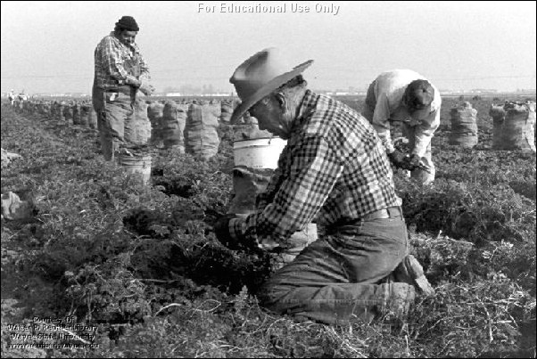
General Idea of “Migrant Farmworker”
The “Migrant Clinicians Network” defines a migrant farm worker as:
“ A migrant farmworker is defined as an individual who is required to be absent from a permanent place of residence for the purpose of seeking employment in agricultural work. Migrant farmworkers are also called migratory agricultural workers. Seasonal farmworkers are individuals who are employed in temporary farmwork but do not move from their permanent residence to see farmwork; they may also have other sources of employment.”

Slide 7
Facts about Migrant Farmworkers
The idea of the “circuit”
Annual salary of $12,500-15,000 individually; those with families make between $17,500 to $19,999(National Farm Worker Ministry).
Work long hours and work is physically very strenuous on the body
Many health hazards; for example, coming in close contact to pesticides, skin rashes/cancer, heat exhaustion and much more. (Maureen Anthony, “Caring for Migrant Farm Workers on Medical-Surgical Units”)
Notes:
The “circuit”-never in one place at one time and they do not have a permanent site for living; they move wherever the work is. For this reason you will hear people talk about the circuit of farm working. Migrant workers will “work the circuit” so to speak, as in certain times of the year they can find work in a certain area and other times of the year they will find work elsewhere.
Migrant farm workers work long hours and the work they do is physically very strenuous on the body. In my research I found the article by Maureen Anthony that demonstrated or touched on only a few health issues migrant farmworkers encounter.

Slide 8
Health Care for Migrant Farmworkers
“An estimated 300,000 farm workers are poisoned every year by pesticides used to protect crops from damage. Exposure to chemicals on farms is known to be associated with a variety of serious health outcomes, including respiratory and dermatologic conditions, birth defects and fertility problems, cancer, and rarely, convulsions, coma, and death(NCFH, 2009).”
-Maureen Anthony
Other common diseases found among seasonal and migrant farmworkers are shigellosis, dysentery, tuberculosis, sexually transmissible diseases, dental and eye problem(National Migrant Resource Program, 1992; Wilk, 1989; Wingo, Borgstrom, Miller, and Division of Tuberculosis Control Centers for Disease Control, 1986).
Notes:
These are a few studies and critical articles that I found to support my research about the migrant farm working community. As said in the top part, 300,000 farm workers are poisoned every year by pesticides used to protect crops and it can cause many health problems for the workers. And many are not given paid sick days or days of absence to get these health issues examined or to take care of themselves.
Below are a few other examples of diseases that farm workers are commonly reported to have such as tuberculosis and dental and eye problems. Now that we have a few more examples of issues farm workers face and we have an idea of what a migrant farm worker is we are going to go ahead and look at the three pieces of literature picked out to analyze and talk further about.

Slide 9
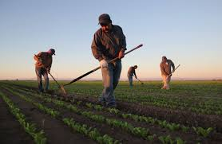
Contributions of the Migrant Farm Working Community
Migrant farm labor supports 28 billion dollars in the fruit and vegetable industry.
Studies have shown that an increase in the farmworker population over the last decade has shown an increase in the overall economic output of the regions where they work
If we were to eliminate the presence of farmworkers it would have a negative impact on the agricultural regions and the community
There would be less jobs available to permanent local residents.
(National Center for Farmworker Health, Inc. 2012)
Notes:
Dice que los trabajadores migrantes contribuyen 28 miles de millones de dolares a la industria de verduras y frutas porque hay 3 millones de personas trabajando en la industria agricultura. Si tuviéramos que deshacerse de los trabajadores agrícolas migrantes que sería en realidad tienen un impacto negativo en la comunidad. Cuando pensamos en Salinas, nuestra comunidad de la agricultura local, debemos pensar en la importante contribución de los trabajadores agrícolas migrantes están haciendo a la comunidad y la cantidad de este grupo de personas es compatible con las bases de Salinas.

Slide 10
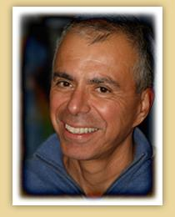
Elements of San Joaquin by Gary Soto
“Field” (pg 15)
The wind sprays pale dirt into my mouth
The small, almost invisible scars
On my hands.
The pores in my throat and elbows
Have taken in a seed of dirt of their own.
After a day in the grape fields near Rolinda
A fine silt, washed by sweat,
Has settled into the lines
On my wrists and palms.
Already I am becoming the valley,
A soil that sprouts nothing
For any of us.
Notes:
The opening line of this poem leaves the reader with the image of a person working in a dirt field where there is nothing but wind and earth. We can also see that the narrator has scars from past work that are almost there; and almost hurt, but don’t. One of the most important parts of the poem, I think, is the ending where he says “A soil that sprouts nothing/ For any of us” as if saying that they do work in the field and help grow the harvest, but they never get anything that sprouts from the harvest/they are just the workers who cultivate. This also leaves the reader feeling a sense of emptiness. This poem also came from Gary Soto’s book, Elements of San Joaquin, which is book of poems split into parts that represent the different elements that effect the works and harvest of the San Joaquin Valley in California. Gary Soto is one of the author’s that had personal experience of working in the fields of San Joaquin and understanding the lives of the migrant farm working community.

Slide 11
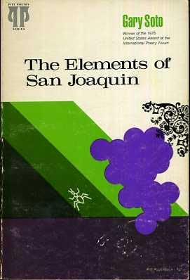
Analysis of Elements of San Joaquin
The field used as an example of life in the San Joaquin Valley
The “invisible scars” on the narrator’s hands
Feeling of emptiness and solidarity
The final stanza, “A soil that sprouts nothing/for any of us”

Slide 12
Operation Wetback by Diana Garcia
Operation Wetback, 1953
The day beings like any other day.
Your daughter soaks a second diaper,
chortles as she shoves her soft-cooked egg
to the floor. Knees pressed to cracked linoleum,
you barely notice as your husband strokes
your belly. Mijo he croons, prophetic plea,
then squeezes your nalgas as if to gauge
for ripeness. As he edges past, you notice
how his blue shirt blurs against the summer sky,
how sky absorbs his patch of blue, then empties.
moments later, a truck groans, moves on,
carting rumblings of men headed for the fields.
Years later, you tell your son and daughter
of that anguished day, how green card migrants
vanished from the camps. You tell your children
how news gripped the camps of trains headed south
loaded with wetbacks. You never tell your children
what you can’t forget: how you failed to squeeze back,
failed to wave good-bye, failed to taunt him
with viejo sinverguenza. You never tell your children
how you forgot this one man’s voice-a voice
that brushed your ears, your hair, a path down your back-
a voice that blends with sounds of a truck
that never brought him home.

Slide 13
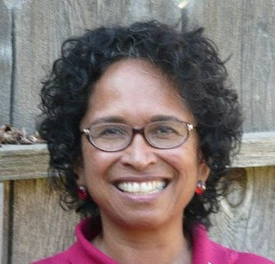
Operation Wetback Analysis
The term “wetback”
Operation Wetback in the 1950s
Image of a mother with children; without father
Separated family
Notes:
The term “wetback” refers to Mexican immigrants who immigrated here by swimming or walking through the Rio Grande; which separates Mexico from the United States. It was a term put in place during the 1940s when many Mexicans were crossing the border and used very loosely during the 1950s when the actual “Operation Wetback” took place.
Operation Wetback was what the United States called it’s Border Patrol that “hunted” and took undocumented Mexican immigrants back across the border. Many Americans were complaining about Mexicans during this time period because they were supposedly taking up too many jobs that Americans wanted.
Diana Garcia wrote this poem in 1953 at the height of Operation Wetback; when many Mexican families were separated. As showed in this poem; the workers would leave for the fields full of undocumented, Mexican citizens and at the end of the day the families never knew who would return and who wouldn’t; which leaves us with the image of a mother expecting a child and the father has been ripped away from them. And as it says “years later”; we can interpret that the family was never reunited with the father and they cannot find him. This was a real life struggle of many migrant farm workers during the 50s and even today.

Slide 14
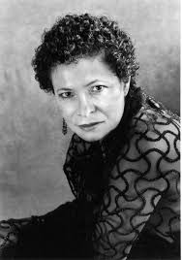
Helena Maria Viramontes
Wrote the novel, “Under the Feet of Jesus”.
Grew up in L.A.
Much of her writing is stories and experiences with her own family and neighborhood.
Many of her writing and scenes she chose were also taken from her husband.
Notes:
The next piece of literature we are going to look at is a novel written by Helena Viramontes, called “Under the Feet of Jesus”, she grew up in L.A. and many of her stories and writings came from experiences with her neighborhood and her own family.
She also got many ideas from her husband, who, when he was younger worked in the fields and spent a lot of time in the hot sun. In an interview with Isabel Dulfano, Helena Viramontes says that her husband used to talk about how when it was really hot outside he would find shade by going under an old car sitting around. In her book, Under the Feet of Jesus, she uses this as a scene where we find the main character under a truck, avoiding the sun and taking a rest.

Slide 15
Under the Feet of Jesus by Helena Viramontes
“Alejo slid through the bushy branches, the tangled twigs scratching his face, and he was ready to jump when he felt the mist. He shut his eyes tight to the mist of black afternoon. At first it was just a slight moisture until the poison rolled down his face in deep sticky streaks. The lingering smell was a scent of ocean salt and beached kelp until he inhaled again and could detect under the innocence the heavy chemical choke of poison. Air clogged in his lungs and he thought he was just holding his breath, until he tried exhaling but couldn’t, which meant he couldn’t breathe. He panicked when he realized he was choking, clamped his neck with one hand, feeling his Adam’s apple against his palm, but still held onto a branch tightly with the other, afraid he would fall long and hard, like the insects did. He swallowed finally and the spit in his throat felt like balls of scratchy sand.” (Viramontes, 77)
Notes:
This is one of the most important passages from the book, “Under the Feet of Jesus”, where one of the main characters gets sprayed by pesticides. His name is Alejo and he talks about how the overseer wouldn’t always check the fields to see if there were people there or not; they cared more about taking care of the crops. I didn’t put this scene on here, but in the research paper I also included a scene where another main character and her family are coming back from the hospital, after going to see Alejo, and they return without him and everyone is quiet and crying. The author is made to interrupt that Alejo died or is still in the hospital dying from being sprayed by the pesticides and the family didn’t have enough money to help pay for his expenses.

Slide 16
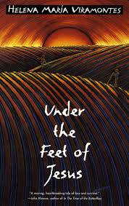
Analysis of “Under the Feet of Jesus
Pesticides when there are workers in the field.
The image of a family without enough money to pay the bills
No health benefits or health coverage for farm workers/field workers
The image of Alejo left in the hospital alone.

Slide 17
Conclusions
Much of the literature written about migrant farm workers is based on stories and experiences from the 1940s and 1950s
In literature, migrant farm workers are portrayed as very hard working individuals.
All of the author’s work used in this research project were, in some way or another, personally affected by working in the fields; either by doing so directly themselves or hearing about it through relatives with experience.
Notes:
Through this research project, I found that much of the literature today is written from stories in the 1940s and 1950s; during a time when Mexican people were first beginning to cross the border either legally or illegally to find work, and the only work they could find much of the time was in the fields. The authors work that I chose to look at was all work that was either written from personal experiences or from experiences from their families.

Slide 18
Bibliography
Day, Deanna. “Persevering with Hope: Francisco Jimenez.” Language Arts, 83.3 (2006): 266.
Dulfano, Isabel. “Some Thoughts Shared with Helena Maria Viramontes.” Women’s Studies, 30.5 (2001): 647-662.
"Facts about Farmworkers." FARMWORKER HEALTH FACTSHEET(n.d.): n. pag. National Center for Farmworker Health, Inc. NCFH, Aug. 2012. Web. 30 Apr. 2016.
García, Diana. "Operation Wetback." When Living Was a Labor Camp. Tucson: U of Arizona, 2000. N. pag. Print.
Jiménez, Francisco. The Circuit: Stories from the Life of a Migrant Child. Albuquerque: U of New Mexico, 1997. Print.
Madden, Robert. “Remembering Cesar Chavez.” Catholic New Times, 27.9 (2003): 7.
Maureen, Anthony J. “Caring for Migrant Farm Workers on Medical-Surgical Units. “Medsurg Nursing: Official Journal of the Academy of the Medical-Surgical Nurses”, 20.3 (2011): 123.
River, Tomas. ...y No Se Lo Tragó La Tierra. Houston, Texas: Arte Publico Press, 1992. Print.
Mejia, James. “Migrant Farm Workers as Environmental Pioneers/Los Trabajadores Migrantes Del Campo Como Pioneros Ambientales.” La Voz Bilingue, 39.16 (2013): 6.

Slide 19
Bibliography cont...
Nahmias, Rick. “From The Migrant Project: Contemporary California Farm Workers.” Gastronomica 4.4 (2004): 72-77.
“National Farm Worker Ministry-Together with Farm Workers Harvesting Justice.” National Farm Worker Ministry RSS, Anonymous. 2016. Web. 18 Feb. 2016.
Pérez, Miguel A, and and others. "Northern California Hispanic Migrant Farm Workers Health Status: A Case Study." Migration World Magazine, 26.1/2 (1998): 17-23.
Rodriguez, Arturo S. “Why Cesar Chavez Led a Movement as Well as a Union.” Harvard Journal of Hispanic Policy, 23 (2011): 15.
Soto, Gary. The Elements of San Joaquin. Pittsburgh: U of Pittsburgh, 1977. Print.
“The Migrant Clinicians Network.” “The Migrant/Seasonal Farmworker. PerfectCube LLC, 2014. Web. 18 Feb. 2016.
Viramontes, Helena. Under the Feet of Jesus. United States of America: First Plume Printing, 1996. Print.

Slide 20
Thank you!

